Slide 1
T.BOT
Personalized Robo-Advisor
Team 3: Dmitry, Vishal, Rimi, Jonathan & Greg

Slide 2
The Problem
A recent study by BMO found that only one third of Canadian investors feel they understand the ins and outs of investing. This lack of understanding is likely why most Canadians work with a financial advisor. Of those who do, 36% don’t feel comfortable making any financial decisions without consulting a professional.
The BMO survey also shows that among Canadian investors, most (62%) have cash in their TFSAs, representing over 40% of their account holdings. Unsurprisingly, mutual funds, typically managed by advisors and money managers (with high fees), make up 42% of the asset allocation in an RRSP.
The lack of knowledge and guidance to investing your hard-earned money without needing to consult a financial advisor or pay high mutual fund fees has led to the development of ‘T.Bot’.

Slide 3
The Solution: T.Bot
T.Bot provides investing guidance based on a series of user inputs that takes in information such as user age, investment horizon, risk factors, and initial investment to drill down to a custom, personal investing solution without the need to consult financial advisors or pay those high mutual fund fees.
T.Bot is programmed to take in user inputs and output a specific portfolio type that the user can feel comfortable investing in, whether short-term or long-term. The portfolios are actively managed to keep the specific balance in the portfolio which gives the user peace of mind and allows them to continually invest without the need to re-balance or worry about allocation.

Slide 4
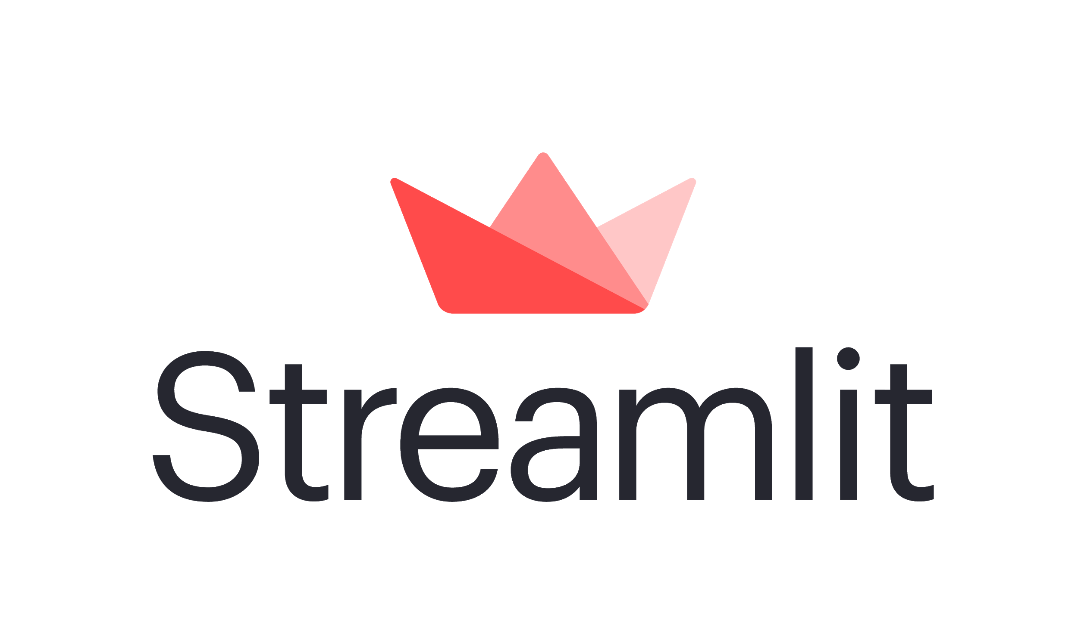
About T.Bot - New Libraries
T.Bot is run on a webapp using Streamlit. Streamlit is an open-source app framework for Machine Learning and Data Science teams.
Some of the libraries used in T.Bot include: Panel, Plotly, Pandas, NumPy, Image, Alpaca, and Scipy.

Slide 5
The Technicals
The code is structured in a way that allows for easy editing and also allows any coder to go in and locate any errors/bugs should they need too. It is structured in order as such:
Import the dependencies, create the environments and import the base data (multiple portfolios/ETFs).
We then run some statistical analysis and Monte Carlo analysis to call on later in the code for visualizations and portfolio analysis.
Each portfolio is then analyzed geographically and also by asset class in order to create some more visuals displayed on the webapp.
The next step is to create the web app, which was done using Streamlit. The user makes inputs on the webapp, which then flows into a decision tree, and outputs a specific portfolio, as well as all of the analysis on the portfolio, which is then displayed to the user.

Slide 6
Next Steps and Plans for T/Bot
The next steps and future of T.Bot would include refining the code and making the input process more seamless, as well as refining the displays and visualizations for a better user experience.
Further down the road, the next steps for T.Bot involve a user creating a custom portfolio of as many stocks/bonds/cryptocurrencies as they would like, and the output would be more advanced analysis such as an in-depth risk analysis, financial ratios, and overall performance of the created, hypothetical portfolio.
Some of the financial ratios include:
Sharpe ratio ;
Treynor Ratio;
As well as Jensen’s Alpha of each created portfolio.

Slide 7
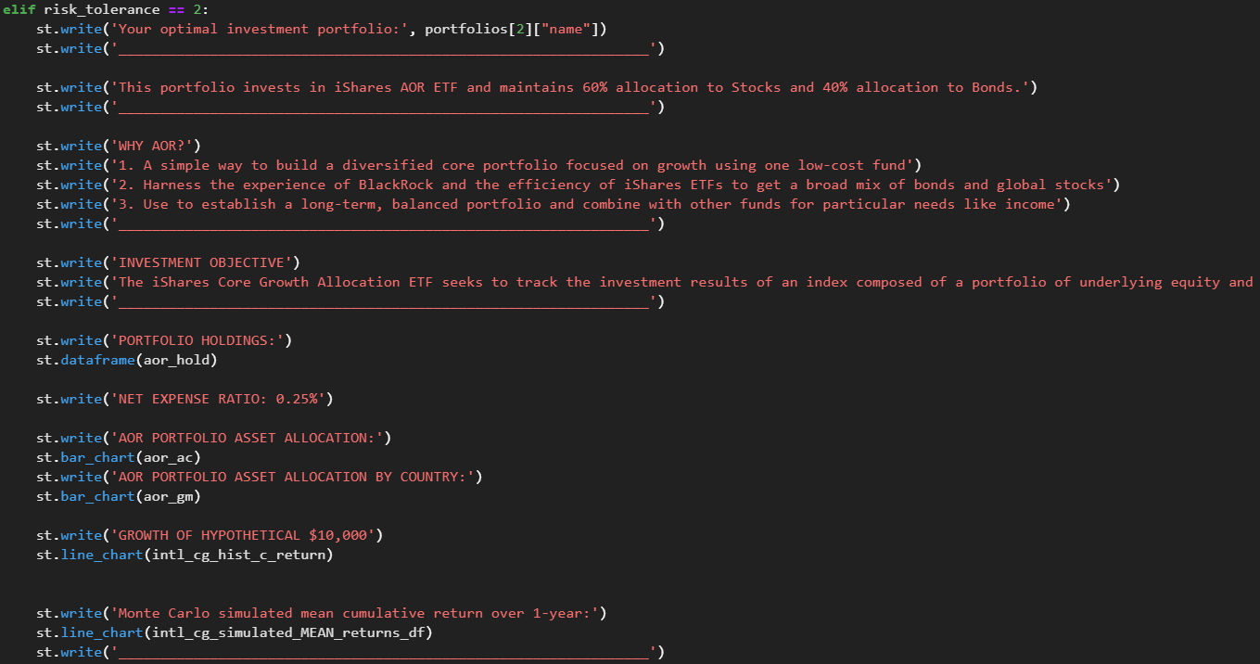
Code Blocks

Slide 8
Let’s Dive In
Live demonstration of T.Bot.

Slide 9
References
https://www.finder.com/ca/stock-trading-statistics

